Slide 1
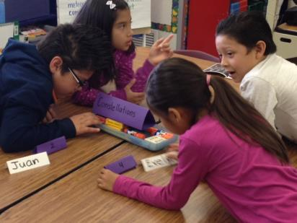
THE SEAL MODEL:
PREVENTING LONG TERM ENGLISH LEARNERS
Preventing Long Term ELs and Newcomer Summit
OCTOBER 24, 2015
Notes:
Each intro ourselves

Slide 2
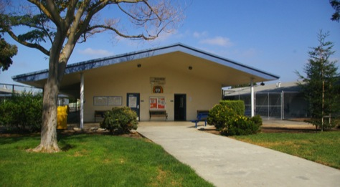
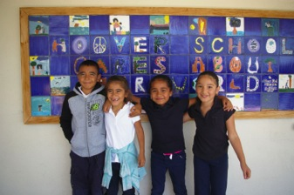
THE BACKGROUND INFORMATION HOOVER ELEMENTARY
K-8 Community School in the Redwood City School District
Heart of Silicon Valley in California
750 students
80% Free and Reduced Lunch
70% Second Language Learners, majority Spanish is first language
Notes:
Amanda

Slide 3
HOOVER ELEMENTARY
2008: my first year as principal at Hoover
Struggled with our early exit bilingual model
Inconsistent practices across classroom
Inconsistent bilingual and SEI program design
Veteran teachers, high administration turnover
Many students not progressing after intermediate level on English Language Development test
Program Improvement, Year III
Notes:
Amanda

Slide 4
HOOVER ELEMENTARY & SEAL
2009 Dr. Laurie Olsen approached us to be part of Sobrato Family Foundation pilot program, along with 2 other schools in Bay Area
Sobrato Early Academic Language (SEAL) Pilot:
- started with first preschool cohort in 2010
and followed students up until 3rd grade,
- provided PD and support for grade level teachers as the students moved up each grade
Notes:
Amanda

Slide 5
SEAL MODEL
Dr. Laurie Olsen, leading researcher and author on educational equity
Developed SEAL model to best meet the needs of second language learners and prevent long term EL learners
Designed from the national standards for professional development, research on effective staff development and school improvement
Identified key strategies for second language learners to be proficient in language, many GLAD strategies
Worked with curriculum writers to set up unit design and framework with common core standards and new generation science standards
Notes:
Linda

Slide 6
H
SEAL MODEL ALIGNED WITH NEW CCSS PARADIGM
:
Language is central to all academic areas
MATH
SCIENCE
Language*
*
• instructional discourse
• expressing and understanding reasoning
LANGUAGE ARTS
Notes:
Linda; add the Stanford EL Research on acquiring language

Slide 7
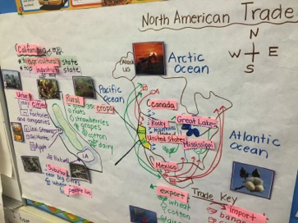
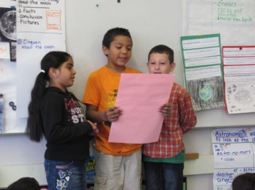
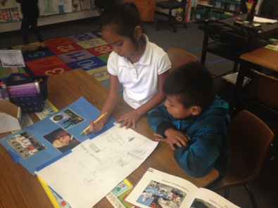
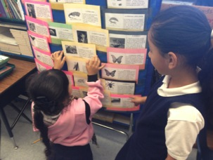
HOOVER SEAL CLASSROOMS TODAY
Notes:
Amanda Oral language
Academic language posted
Collaborative work

Slide 8
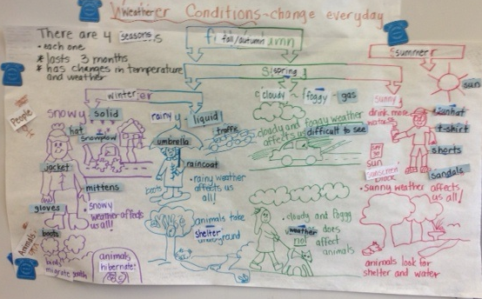
DRAW & LABEL:
TAUGHT WITH CONTENT
Draw and Label: Taught during Content Time
Notes:
Amanda-

Slide 9
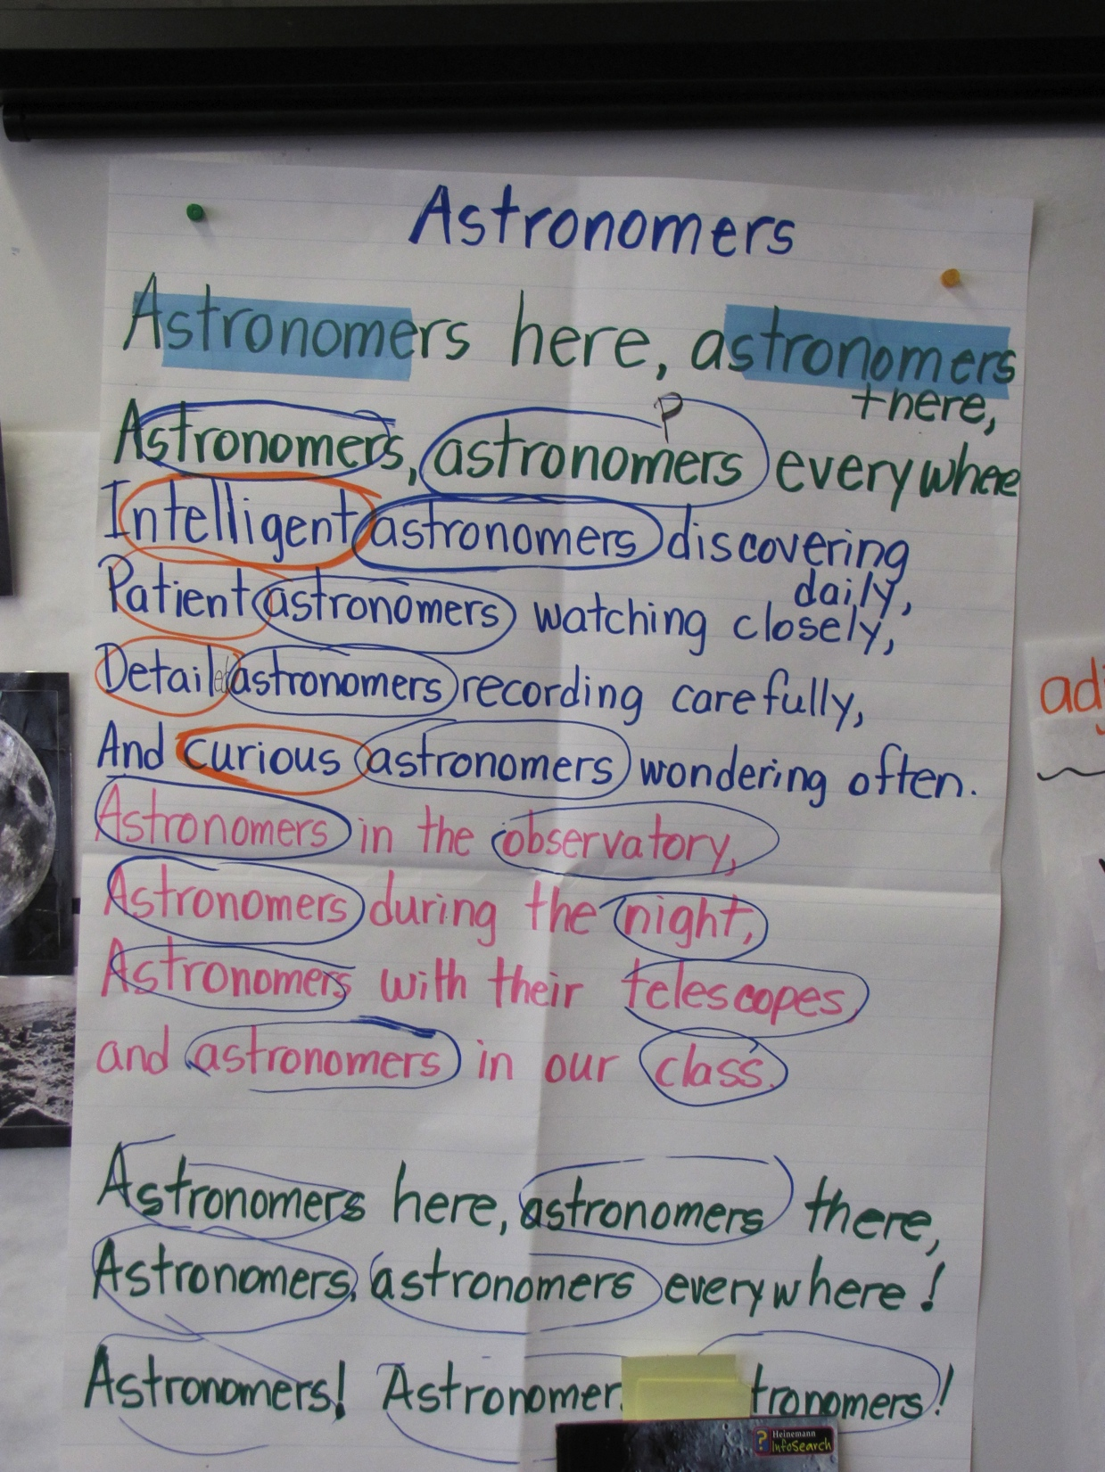
CHANTS REINFORCE LANGUAGE IN DRAW & LABELS, READ ALOUDS, ETC,

Slide 10
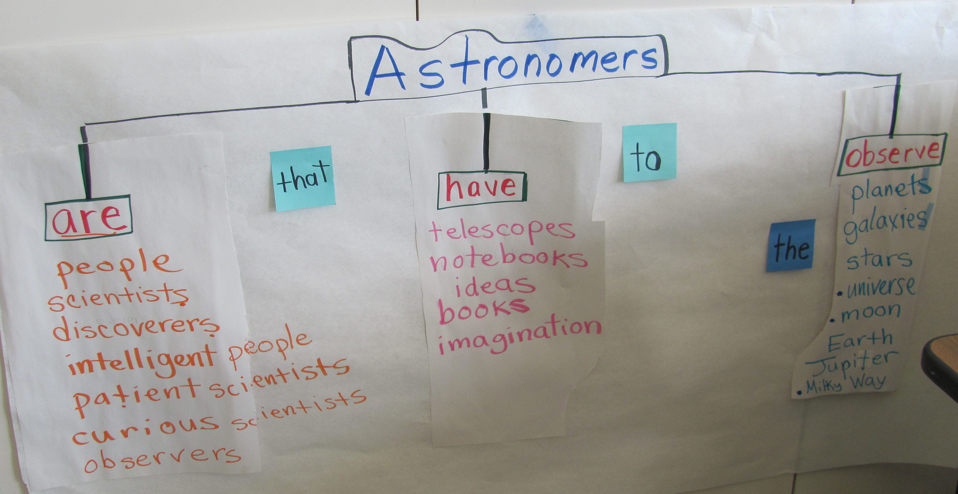
GRAPHIC ORGANIZER: TREE MAP

Slide 11
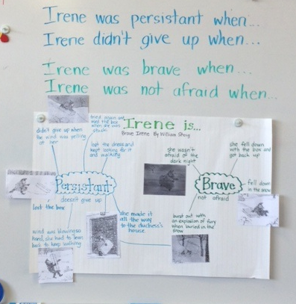
SENTENCE FRAMES FOR SCAFFOLDING

Slide 12
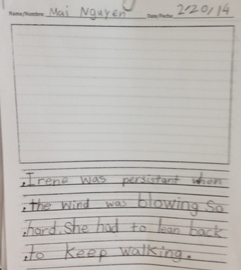
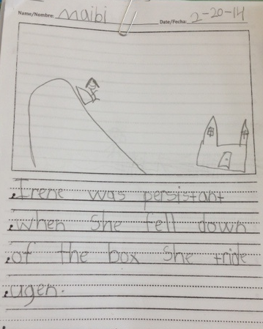
LEADS TO WRITING

Slide 13
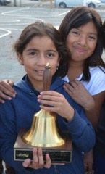
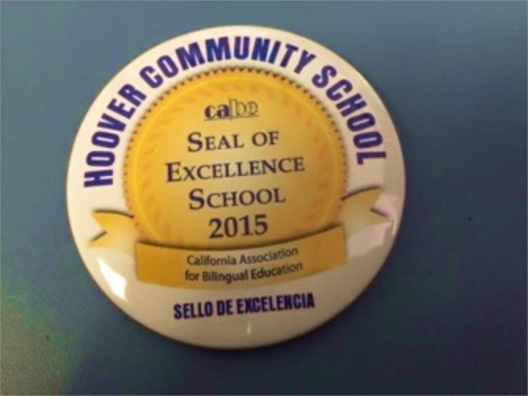
STATE RECOGNITIONS
Golden Bell 2014: Best in Class - Common Core
CABE Seal of Excellence 2015, only 1 out of 3 schools!
2015-16: National Research Council (NCR) will visit Hoover as one of two sites in the nation to tour
• Tom Torlakson invited to visit
• CABE will visit in March

Slide 14
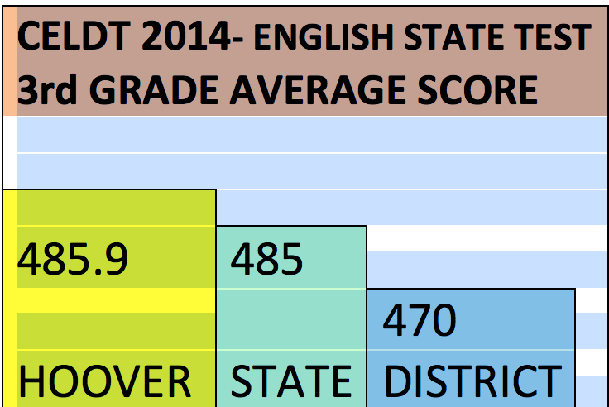
THE SEAL RESULTS AT HOOVER
5th year pilot results – 1st cohort students in 3rd in 2014
75% of the cohort in a bilingual program
Notes:
Linda
On CELDT: ELs in 3rd grade outperformed students in our district and in well established dual language programs in CA
35% of students in bilingual scored advanced or proficient on our state ELA test and 67% scored proficient or advanced on math ELA
By the end of 2nd grade, 2/3 of the the English learner SEAL students had closed the gap with their English only peers

Slide 15
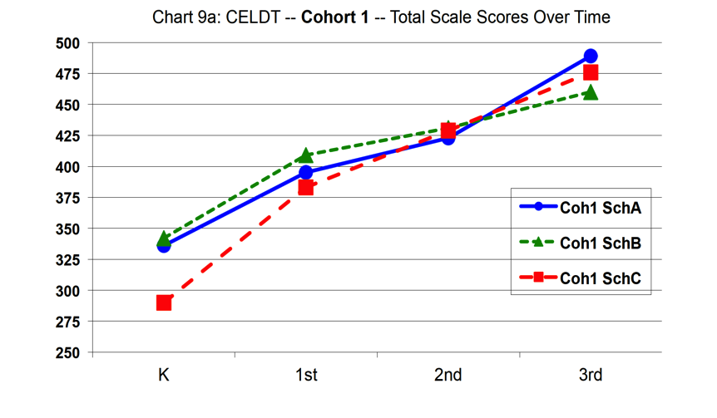
SEAL RESULTS: CELDT TRENDS
School C: Hoover
Students now in 4th grade
Notes:
3 schools in original cohort, 2 other schools in San Jose
Note: Hoover started lower, students come from lower socio economic background, parents with lower education

Slide 16
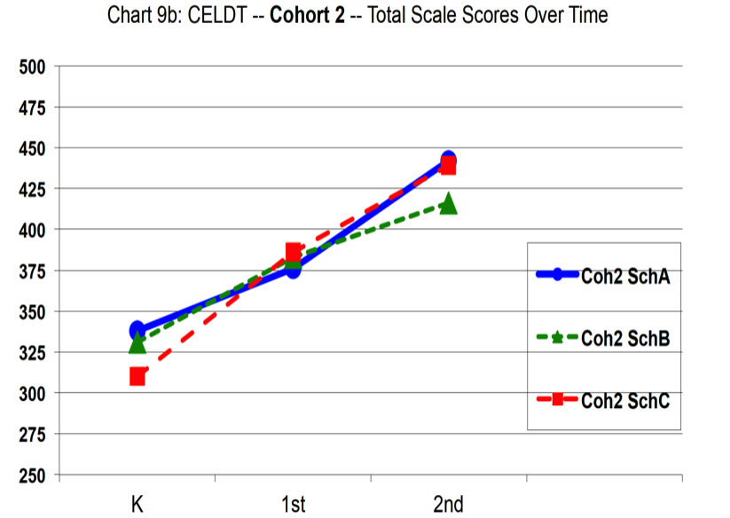
Students now in 3rd grade
Notes:
Teachers learned strategies, outcome stronger

Slide 17
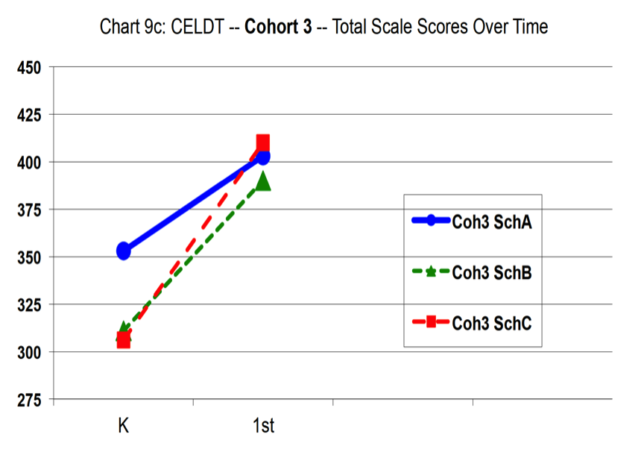
Students now in 2nd grade
Notes:
And even stronger

Slide 18
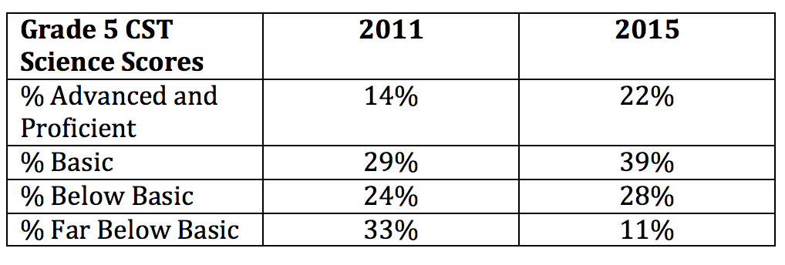
SEAL IMPACT: HOOVER CST SCIENCE
Notes:
Great trend, clear the focus on science in our integrated units is supporting our students content knowledge

Slide 19
HOOVER RECLASSIFICATION DATA
2011 – 42 students
2013 – 45 students
2014 – 64 students
2015- 78 students
Notes:
Linda ends here

Slide 20
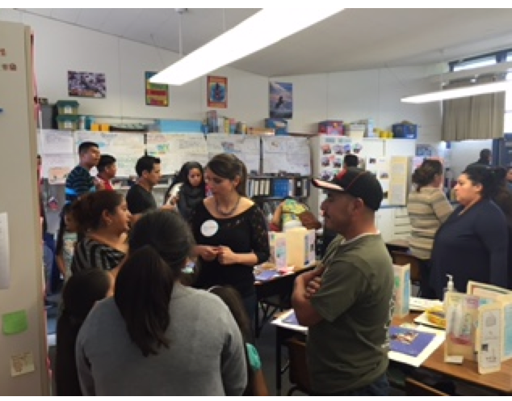
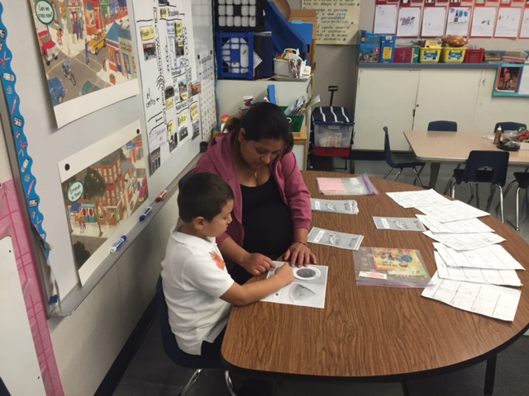
PARENT IMPACT
Family Engagement: percentage of parents participating at an event or volunteering at school, John Gardener Center data for Hoover:
2009: 30%
2011: 55%
2014: 91%
2015: 97%
Hoover parents engaging in
family literacy activities at same
Level as college educated parents
Notes:
Amanda

Slide 21
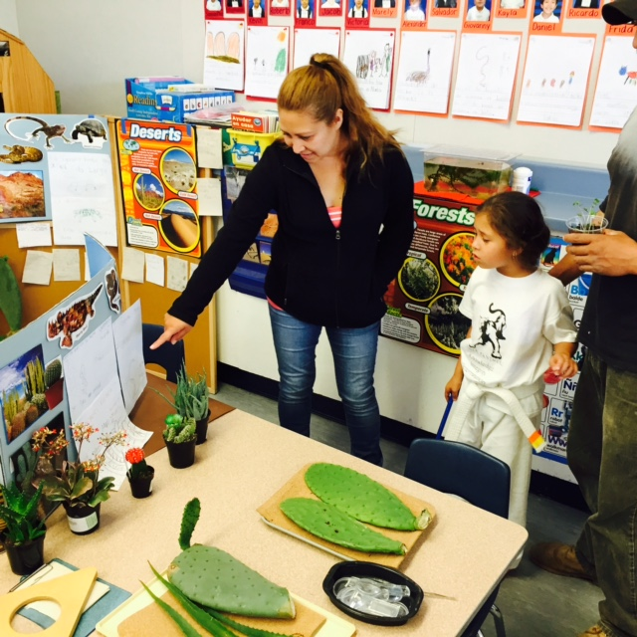
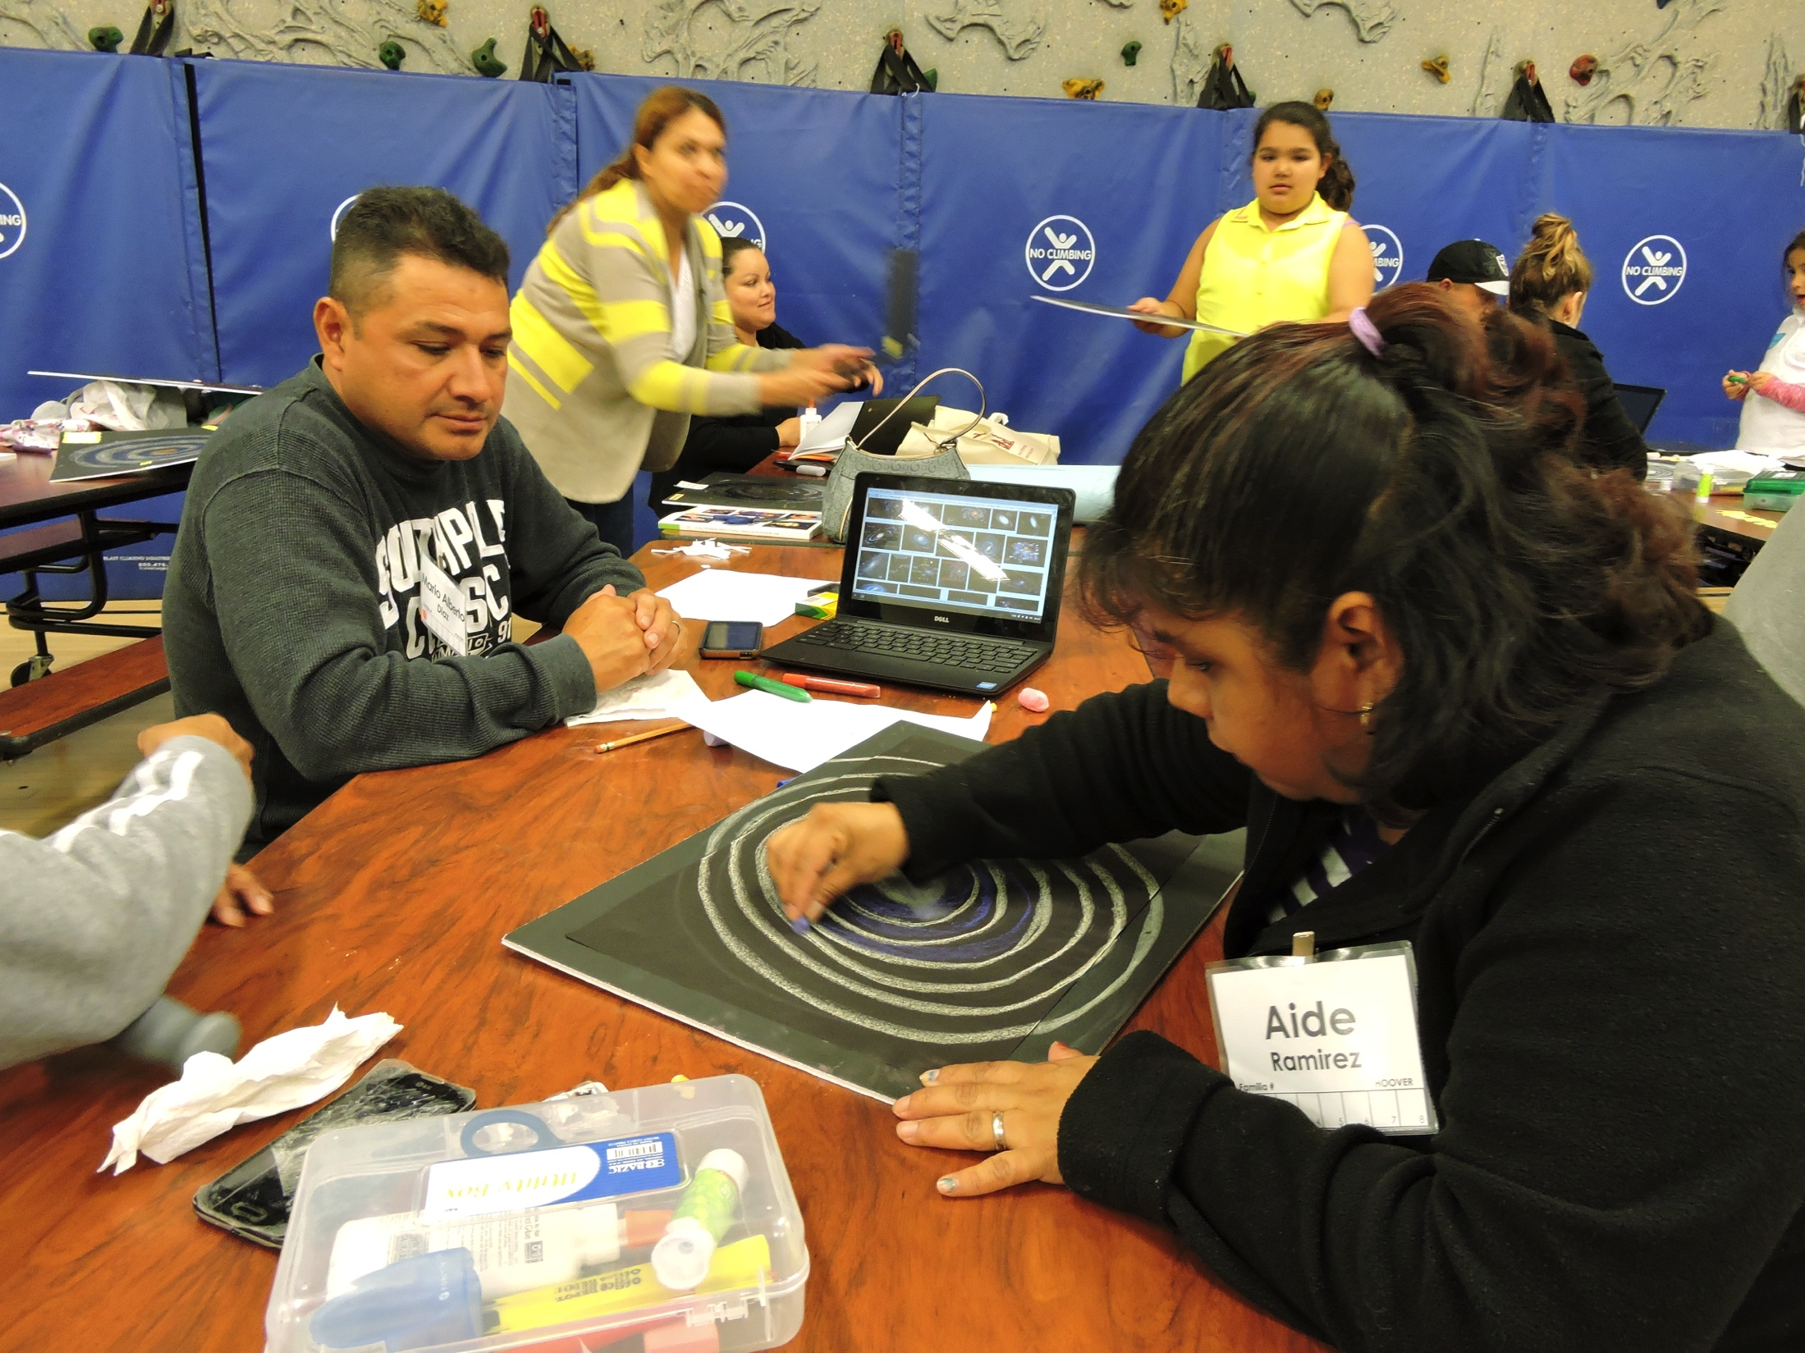
EXAMPLES OF SEAL PARENT COMPONENT
Family Literacy Evenings
Workshops on how to best support teachers in the classroom
Inviting parents into classroom
Gallery walks at end of units
Notes:
Amanda

Slide 22
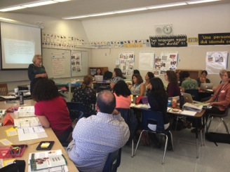
PROFESSIONAL DEVELOPMENT
Learning communities are essential
  Release time during the school day, after school
  Collaboration within and across grade levels
  Time to read and reflect on the latest research
    National Literacy Panel on Language Minority and Children
  Planning units and professional dialogue
  Reflecting on teaching practices and student work
Notes:
Linda
Moving to a district level model
With coaches is essential

Slide 23
PROFESSIONAL DEVELOPMENT
Both bilingual and SEI teachers included in PD
= coherence and rigor across programs
Additional training needed for bilingual teachers
Know the latest research on language acquisition and transference
Define consistent bilingual program model
Researchers Kathy Escamilla, Sylvia Duque-Reyes supported our trainings
Notes:
Amanda

Slide 24
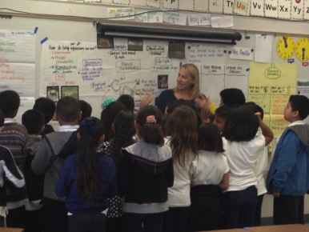
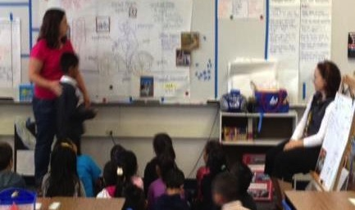
PROFESSIONAL DEVELOPMENT
The follow up support is critical
On site coach to model, demonstration lessons, debrief with teachers
Ideal: teachers co-teach in summer bridge
Notes:
Amanda

Slide 25
THE SEAL MODEL
SEAL
In RCSD: SEAL now in 8 schools, all preK, all TK
Now in 30 Silicon Valley schools
Serving more than 20,000 students
Two year teacher training with 6 modules
By 2019: will train more than 2000 teachers
For more information about SEAL or to arrange a tour contact Amanda Rothengast at arothengast@rcsdk8.net or
Patty Delany pdelany@sobrato.org
Notes:
Demo site: Monthly tours
District level implementation
Time commitments, partnerships with Sobrato and district

